Slide 1
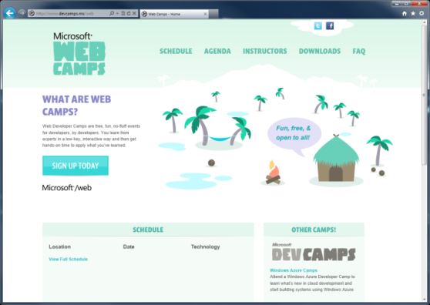

WebCamps Online
Twitter: Follow @webcamps Hashtag #devcamps
[Speaker] / [Twitter]
Website: http://www.devcamps.ms/web
What are web camps?
Web Developer Camps are free, fun, no-fluff events for developers, by developers. You learn from experts in a low-key, interactive way and then get hands-on time to apply what you’ve learned.
Notes:
How does ASP.NET Web API fit in? (10)
Introduction to Web API
File / New project and looking at the Values Controller (5)
Help documentation & Tracing (5)
Exploring services with browser tools (5)
Creating a Person service (5)
Consuming an ASP.NET Web API from jQuery
File / New (10)
Deploy to Azure (5)
Consuming an ASP.NET Web API from Windows 8 (10)
Challenge: First person to insert their contact information wins a prize (5)

Slide 2
Building a Service Layer with ASP.NET Web API
[Speaker]
[Company]

Slide 3
Module Overview
How does ASP.NET Web API fit in?
Introduction to Web API
Consuming Web API from jQuery
Consuming Web API from Windows 8

Slide 4
How ASP.NET Web API Fits In



HTML
JSON
XML
Web Forms
Web Pages
MVC
Web API
ASP.NET Core

Slide 5
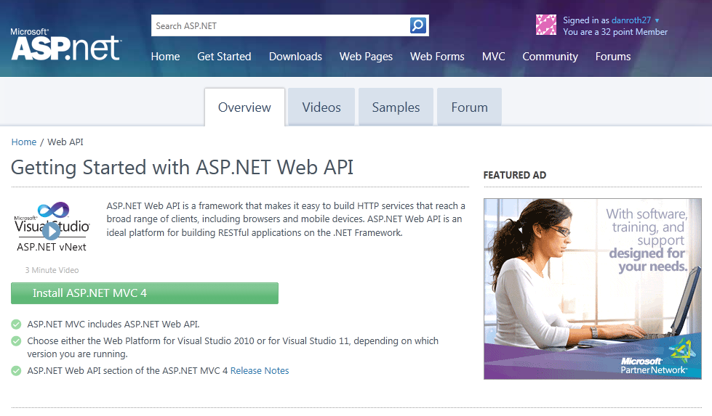
Homepage: asp.net/web-api

Slide 6
Sample Read-only Model and Controller
Step 1:
Create a Model
public class Person
{
public int Id { get; set; }
public string Name { get; set; }
}
Step 2:
Make an API Controller
public class PersonController : ApiController
{
List<Person> _people;
public PersonController()
{
_people = new List<Person>();
_people.AddRange(new Person[]
{
new Person { Id = 1, Name = "Chuck Norris" },
new Person { Id = 2, Name = "David Carradine" },
new Person { Id = 3, Name = "Bruce Lee" }
});
}
}

Slide 7
Read-only Controller Actions to return data
Step 3:
Return everything
// GET /api/person
public IEnumerable<Person> Get()
{
return _people;
}
Step 4:
Return one item
// GET /api/person/5
public Person Get(int id)
{
return _people.First(x => x.Id == id);
}

Slide 8
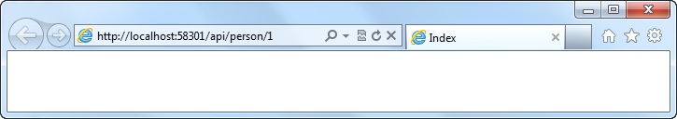
Routing a Web API
Routing:
Familiar syntax, conventional approach
public static void RegisterRoutes(RouteCollection routes)
{
routes.MapHttpRoute(
name: "DefaultApi",
routeTemplate: "api/{controller}/{id}",
defaults: new { id = RouteParameter.Optional }
);
}

Slide 9
Manipulating HTTP Responses
Return HttpResponseMessage<T> to modify response headers
Example
Find a person and return it, but what happens if we don’t find a match?
// GET /api/person/5
public HttpResponseMessage<Person> Get(int id)
{
try
{
var person = _people.First(x => x.Id == id);
return new HttpResponseMessage<Person>(
person,
HttpStatusCode.OK
);
}
catch
{
return new HttpResponseMessage<Person>(HttpStatusCode.NotFound);
}
}

Slide 10
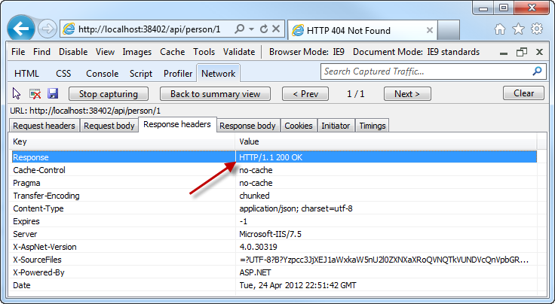
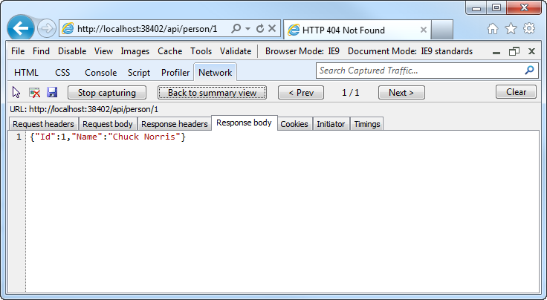
Manipulating HTTP Responses
A successful API call returns an HTTP OK and the JSON data

Slide 11
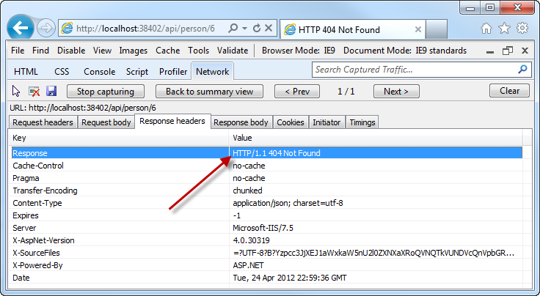
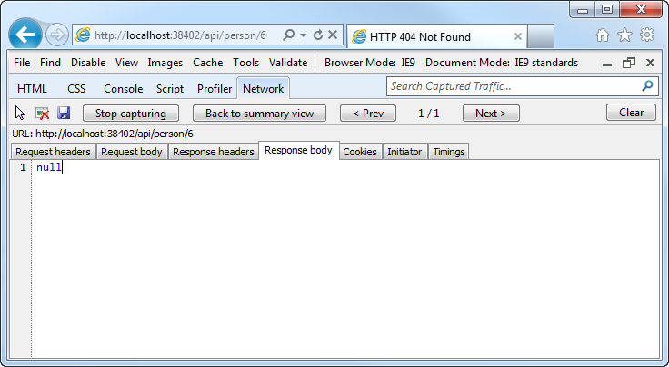
Manipulating HTTP Responses
An unsuccessful API call returns an HTTP 404 (and no JSON)

Slide 12
Posting Data to a Web API
Use HTTP Post:
Pass a Model
public HttpResponseMessage Post(Person person)
{
person.Id = _people.Count + 1;
if (_people.Any(x => x.Id == person.Id))
return new HttpResponseMessage(HttpStatusCode.BadRequest);
try
{
_people.Add(person);
}
catch
{
return new HttpResponseMessage(HttpStatusCode.BadRequest);
}
return new HttpResponseMessage(HttpStatusCode.OK);
}

Slide 13
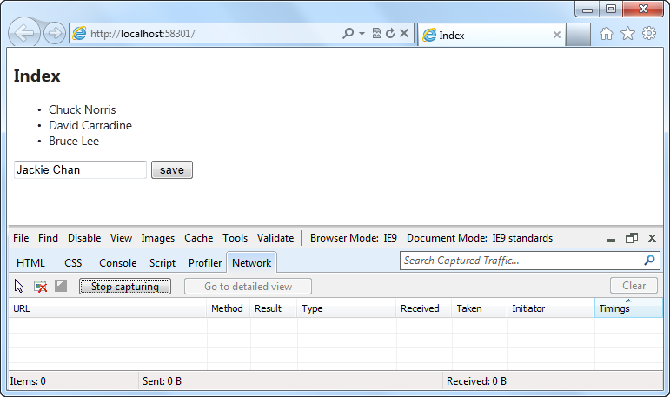
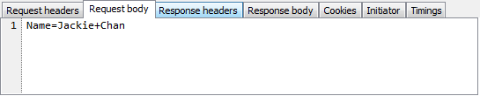
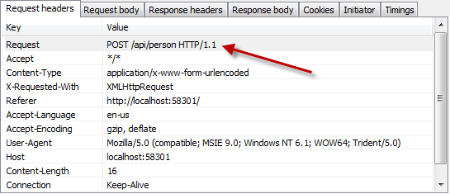
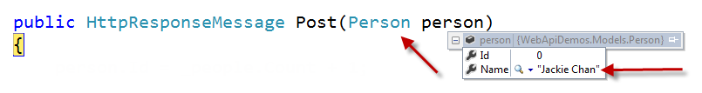
Posting Data to a Web API

Slide 14
Introduction to ASP.NET Web API
demo
Notes:
File / New project and looking at the Values Controller (5)
Help documentation & Tracing (5)
Exploring services with browser tools (5)
Creating a Person service (5)

Slide 15
Windows Store Apps Talk to WebAPI
Demo
Notes:
Show how Windows Store App talks to WebAPI
Without change, Windows Store App can use form authentication
With slight modification, windows store app can use webAPI with facebook authentication (not the best technique here, possibly use HttpClient to do it)

Slide 17
Comparison of WCF & ASP.NET Web API
WCF
Back-end Services
SOAP, WS-*
ASP.NET Web API
Front-end Services
Media Types: JSON, XML, form-URL-encoded, custom
Transports: HTTP, TCP, UDP, Queues, WebSockets, custom
Message patterns: request-reply, one-way, duplex
Use WCF Web HTTP to add HTTP endpoints to existing WCF services
Use WCF Data Services for full OData support
HTTP only
Request-reply only
REST, resource-centric
Use SignalR for asynchronous signaling (polling, long-polling, WebSockets)

